Slide 1
Control Structures
Control Statements
Decision making / Branching
Looping / Iteration
Jumping
Notes:
Title + Text

Slide 2
Branching
- Decides what actions to take
Looping
Decides how many times to
take a certain action.

Slide 3

Decision Making / Branching
Notes:
Title + Image + Text

Slide 4
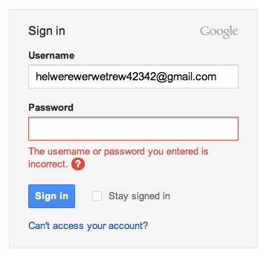
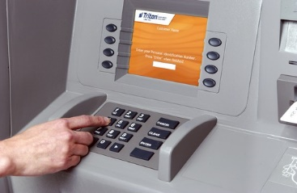
Where we are using decision making?
Notes:
Title + Image + Text

Slide 5
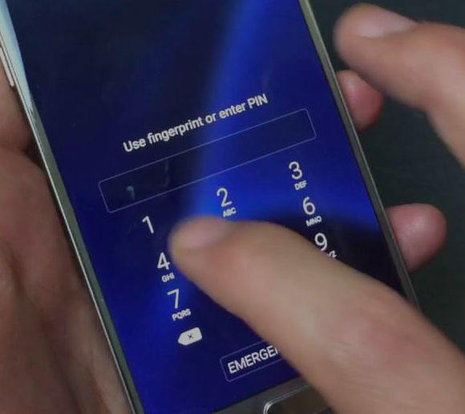

Where we are using decision making?
Notes:
Title + Image + Text

Slide 6
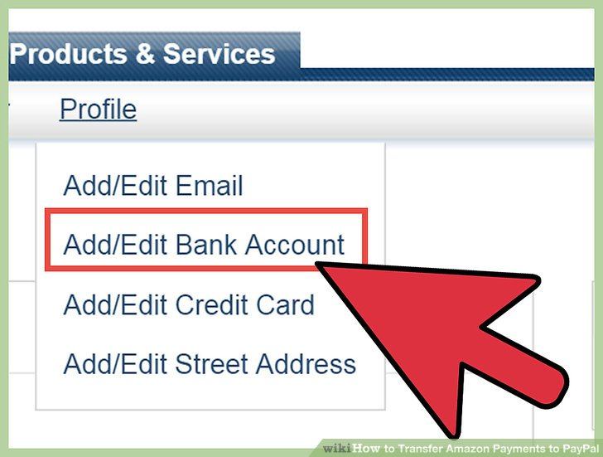
Where we are using decision making?
Notes:
Title + Image + Text

Slide 7
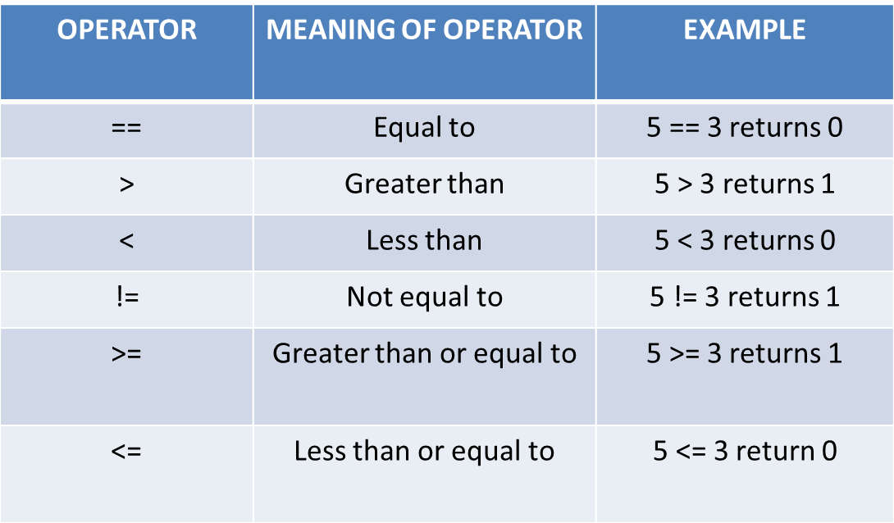
Conditions
Conditions are formed by relational operators.
Notes:
Title + Image + Text

Slide 8
Types
If – Else
Cascaded ( If – Else – If )
Nested If
Switch Case
Notes:
Title + Text

Slide 9
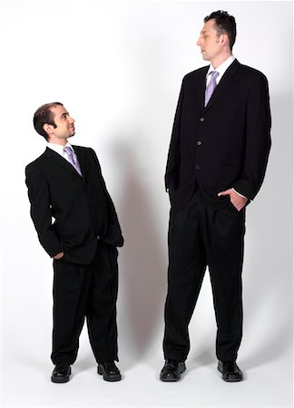
Who is Taller ?
How will you find it ?
By comparing
How to do that in programming ?
Using Relational Operators

Slide 10
// Pseudocode
If(height of person 1 > height of person 2)
{
Print(“Person 1 is taller”)
}
Else
{
Print(“Person 2 is taller”)
}
1
2
3
4
5
6
7
8
9
10
11
12
13
14
15
16
17
18
19
20
21
22
Notes:
Ask a student, Is there any other logic to solve this problem?

Slide 11
// Pseudocode
If(height of person 1 < height of person 2)
{
Print(“Person 2 is taller”)
}
Else
{
Print(“Person 1 is taller”)
}
1
2
3
4
5
6
7
8
9
10
11
12
13
14
15
16
17
18
19
20
21
22

Slide 12
If- Else Statement
Syntax:
if(condition) {
//code to be executed if condition is true
}
else {
//code to be executed if condition is false
}

Slide 13
// Code
#include<iostream>
using namespace std;
int main()
{
int h1,h2;
cin >> h1 >> h2
if(h1 > h2)
cout << ”Person 1 is taller";
else
cout << "Person 2 is taller“;
return 0;
}
1
2
3
4
5
6
7
8
9
10
11
12
13
14
15
16
17
18
19
20
21
22

Slide 14
Question 1
Which one of the following condition(s) has to be satisfied to check if a person is eligible to donate blood?
A) Age > 18
B) Weight > 50
C) Both A and B
D) None of the Mentioned
Notes:
Answer: Option C
Ask the students, How will you write this in programming?
Using logical operators

Slide 15
Logical Operators
Operators | Meaning
&& | AND
|| | OR
! | NOT

Slide 16
// How to use Logical operators in the program
// Pseudocode
If(age of person > 18) && (weight of person > 50 kg)
{
Print(“Eligible to donate blood”)
}
Else
{
Print(“Not eligible”)
}
1
2
3
4
5
6
7
8
9
10
11
12
13
14
15
16
17
18
19
20
21
22

Slide 17
// Code
#include<stdio.h>
int main()
{
int age, height;
cin >> age >> height;
if(age > 18) && (height >50)
cout << "Eligible to donate blood";
else
cout << "Not Eligible to donate blood";
return 0;
}
1
2
3
4
5
6
7
8
9
10
11
12
13
14
15
16
17
18
19
20
21
22

Slide 18

Who is taller ?
How will you find it ?
By Comparing
How to do that in programming ?
Notes:
Ask students to write a program to find the highest among 6 students

Slide 19
Cascaded (if - else if)
Syntax:
if(condition1) {
//code to be executed if condition1 is true
}
else if(condition2) {
//code to be executed if condition2 is true
}
else if(condition3) {
//code to be executed if condition3 is true
}
else{
//code to be executed if all the conditions are false
}

Slide 20

Decision Making in PUBG
PUBG players are not going to get a Chicken Dinner anytime soon without the ability to aim at targets and take them down with relative ease. So to aim the target they must use scope. It can take hundreds of rounds before you become more comfortable with all the weapons on offer and start landing your shots, but we’re here to help speed that process up.
Notes:
Title + Image + Text

Slide 21
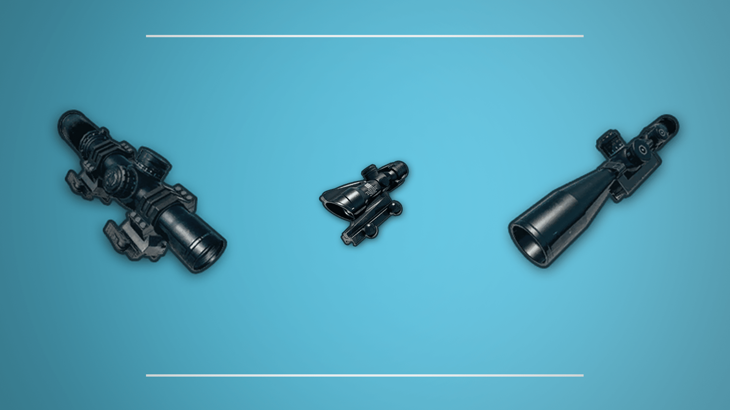
Decision Making in PUBG
Conditions:
If you have 8x scope, Use snipper gun.
If you have 6X scope, Use AUG A3, GROZA, QBZ, M16A4, M416 .
If you have 4x Scope, Use UMP9, AKM, SCAR-L, Cross Bow .
If you have 2x Scope, almost all guns.
If you don’t have scope, find one.
Notes:
Now Let’s help them by writing a program which helps them
to select the gun based on the scope .

Slide 22
// Pseudocode
if(scope == 8)
{
Print(“Use Snipper”);
}
else if(scope == 6)
{
Print(“Use AUG A3 / GROZA / QBZ / M16A4 / M416 “);
}
else if(scope == 4)
{
Print(“Use UMP9 / AKM / SCAR-L / Cross Bow );
}
else if(scope == 2)
{
Print(“Almost all guns”);
}
else
{
Print(“Find one”);
}
1
2
3
4
5
6
7
8
9
10
11
12
13
14
15
16
17
18
19
20
21
22

Slide 23
// Code
#include<iostream>
using namespace std;
int main()
{
int scope;
cin >> scope;
if(scope == 8)
cout << "Use Snipper";
else if (scope == 6)
cout << "Use AUG A3 / GROZA / QBZ / M16A4 / M416 ";
else if (scope == 4)
cout << "Use UMP9 / AKM / SCAR-L / Cross Bow ";
else if (scope == 2)
cout << "Almost All guns";
else
cout << "Find one";
return 0;
}
1
2
3
4
5
6
7
8
9
10
11
12
13
14
15
16
17
18
19
20
21
22

Slide 24
Nested If
Syntax:
if (condition1)
{
// code to be executed if condition1 is true
if (condition2)
{
// code to be executed if condition2 is true
}
}
Notes:
Title + Text

Slide 25

Bunjee Jumping
Have you tried or seen Bunjee Jumping ? It’s a weird experience, Isn’t it?. But if someone is very eager to try bunjee jumping, they must satisfy few conditions
Conditions:
Minimum Weight must be 40 kgs
Maximum Weight must be 110 kgs[If Weight is greater than maximum, extra ropes will be added]
3) Minimum age required is 12 years.
Notes:
So if any person satisfying these criteria, Can enjoy
bunjee jumping.
Now we are going to write a program to check whether
the particular person is satisfying these criterias or not.

Slide 26
// PseudoCode
If(age >= 12)
{
If(weight >= 40)
{
If(weight <= 110)
{
Print(“He can Jump”);
}
Else{
Print(“Extra ropes will be added”);
}
}
Else
{
Print(“He can’t Jump”);
}
}
Else
{
Print(“He can’t Jump”);
}
1
2
3
4
5
6
7
8
9
10
11
12
13
14
15
16
17
18
19
20
21
22

Slide 27
#include<iostream>
using namespace std;
int main()
{
int age, weight;
cin >> age >> weight;
if(age >= 12)
{
if(weight >= 40)
{
if(weight <= 110)
{
cout << “He can Jump”;
}
else
{
cout << “Extra ropes will be added”;
}
}
else
{
cout << “He can’t Jump”;
}
}
else
{
cout << “He can’t Jump”;
}
}
1
2
3
4
5
6
7
8
9
10
11
12
13
14
15
16
17
18
19
20
21
22
23
24
25
26
27
28
29
30
31
32
33
34
35
36
37
38
39
40
41

Slide 28
Switch Case
Syntax:
switch(expression){
case 1:
//code to be executed;
break;
case 2:
//code to be executed;
break;
......
default:
code to be executed if all cases are not matched;
}
Notes:
Title + Text

Slide 29
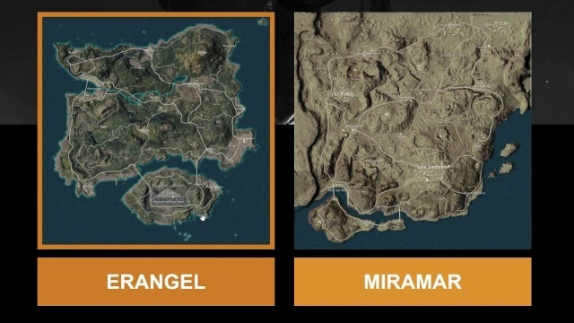
PUBG
Do you know how many maps are there in PUBG ?
Erangel [Forest]
Miramar[Desert]
Sanhok[Rain Forest]
Vikendi[Snow Forest]
Notes:
Title + Image + Text

Slide 30

PUBG
When user enters the corresponding number of maps [1, 2, 3, 4].
It must get into that map, show a Welcome message and
displays the type of that map [Forest, Desert, Rain Forest, Snow Forest].
Notes:
Title + Image + Text

Slide 31

PUBG
Use Switch Case.
Switch case is a multiple-branching statement
Notes:
Title + Image + Text

Slide 32
//Pseudocode
Switch(number)
{
case 1:
Print(“Welcome to Erangel Map. You are Inside a Forest”);
break;
case 2:
Print(“Welcome to Miramar Map. You are Inside a Desert”);
break;
case 3:
Print(“Welcome to Sanhok Map. You are Inside a Rain Forest”);
break;
case 4:
Print(“Welcome to Vikendi Map. You are Inside a Snow Forest”);
break;
Default:
Print(“Invalid Input”);
}
1
2
3
4
5
6
7
8
9
10
11
12
13
14
15
16
17
18
19
20
21
22

Slide 33
#include<stdio.h>
int main(){
int number;
scanf("%d", &number);
switch(number) {
case 1:
cout << "Welcome to Erangel Map. You are Inside a Forest";
break;
case 2:
cout << "Welcome to Miramar Map. You are Inside a Desert";
break;
case 3:
cout << "Welcome to Sanhok Map. You are Inside a Rain Forest";
break;
case 4:
cout << "Welcome to Vikendi Map. You are Inside a Snow Forest";
break;
default:
cout << "Invalid Input";
return 0;
}
}
1
2
3
4
5
6
7
8
9
10
11
12
13
14
15
16
17
18
19
20
21
22

Slide 34
Switch case (Fall Through)
Syntax:
switch(expression){
case 1:
case 2:
case 3:
// Code to be executed
break
case 4:
case 5:
case 6:
// Code to be executed
break
}
Notes:
Title + Text

Slide 35
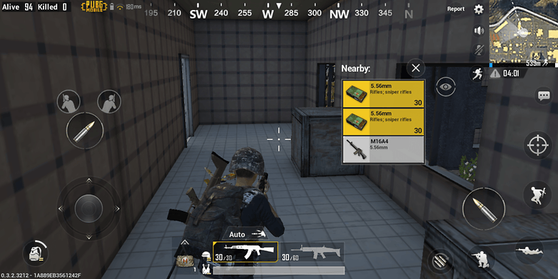
PUBG
After selecting the map in PUBG, the next steps are common in all the maps. Let’s take a look at the steps.
Selecting an area to drop out.
Looting weapons and equipment's.
Stay out of blue circle.
Kill your enemies.
So, for all the four maps, we are going to display these instructions.
So How will you do that ?
Notes:
Title + Image + Text

Slide 36
// Pseudocode
Switch(number)
{
case 1:
case 2:
case 3:
case 4:
Print(“1.Selecting an area to drop out. \n2.Looting weapons and equipments.\n3.Stay out of blue circle.\n4.Kill your enemies.”);
break;
}
1
2
3
4
5
6
7
8
9
10
11
12
13
14
15
16
17
18
19
20
21
22

Slide 37
// Code
#include<iostream>
using namespace std;
int main()
{
int number;
cin >> number;
switch(number)
{
case 1:
case 2:
case 3:
case 4:
cout << “1.Selecting an area to drop out.
\n2.Looting weapons and equipments.
\n3.Stay out of blue circle.
\n4.Kill your enemies.”;
break;
}
return 0;
}
1
2
3
4
5
6
7
8
9
10
11
12
13
14
15
16
17
18
19
20
21
22

Slide 38

THANK YOU
Notes:
Thank you slide

